Slide 1
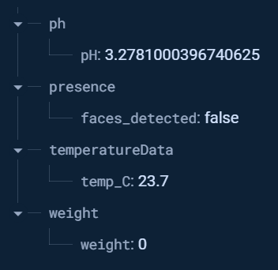

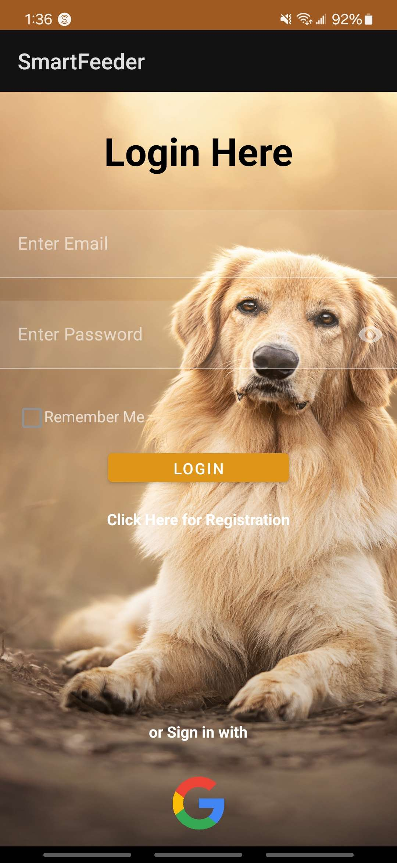
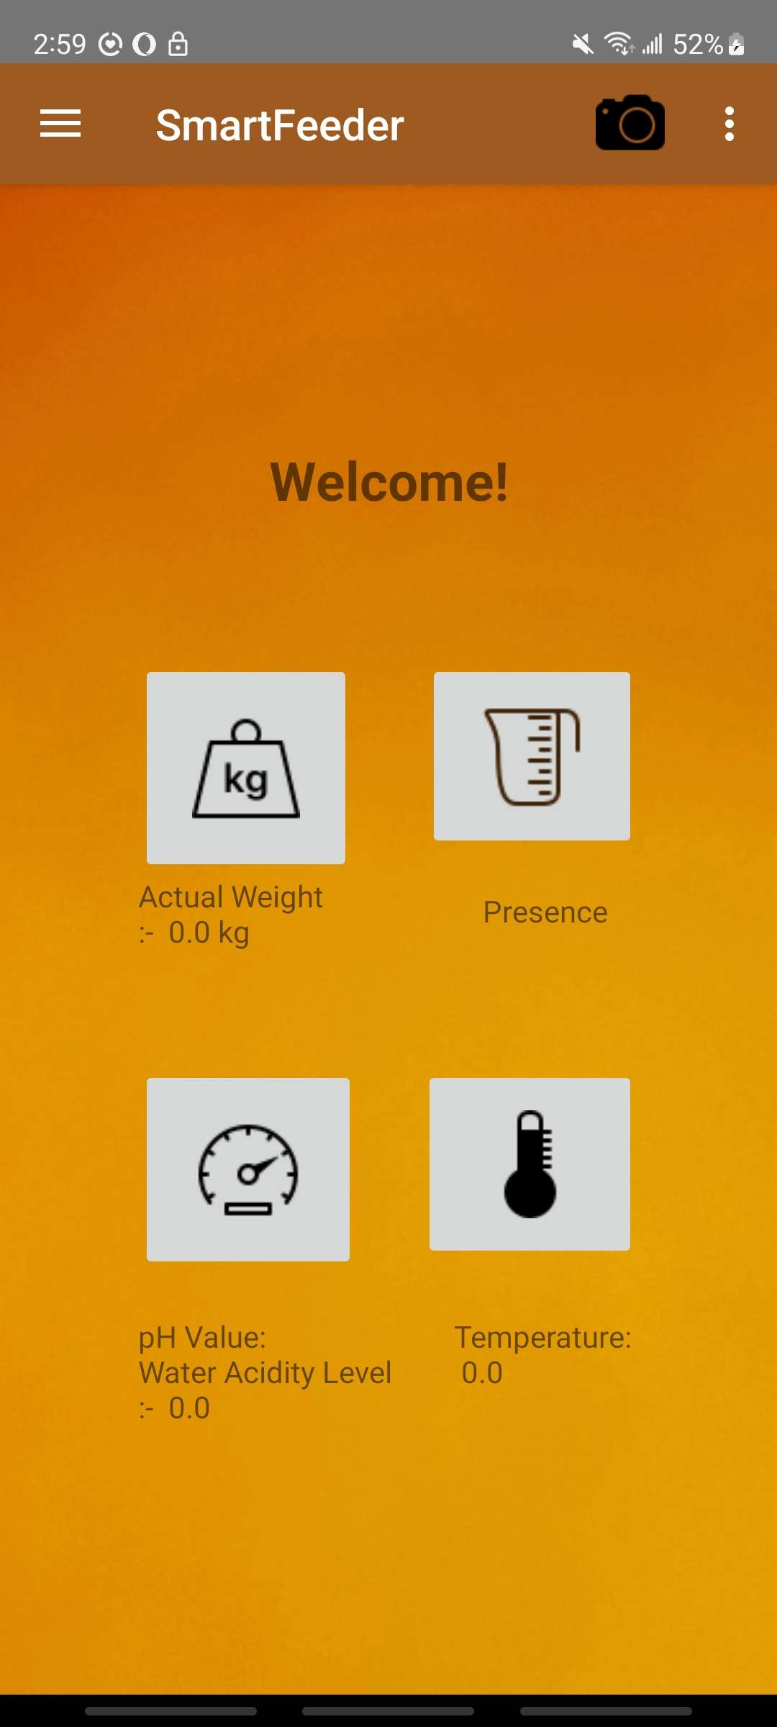
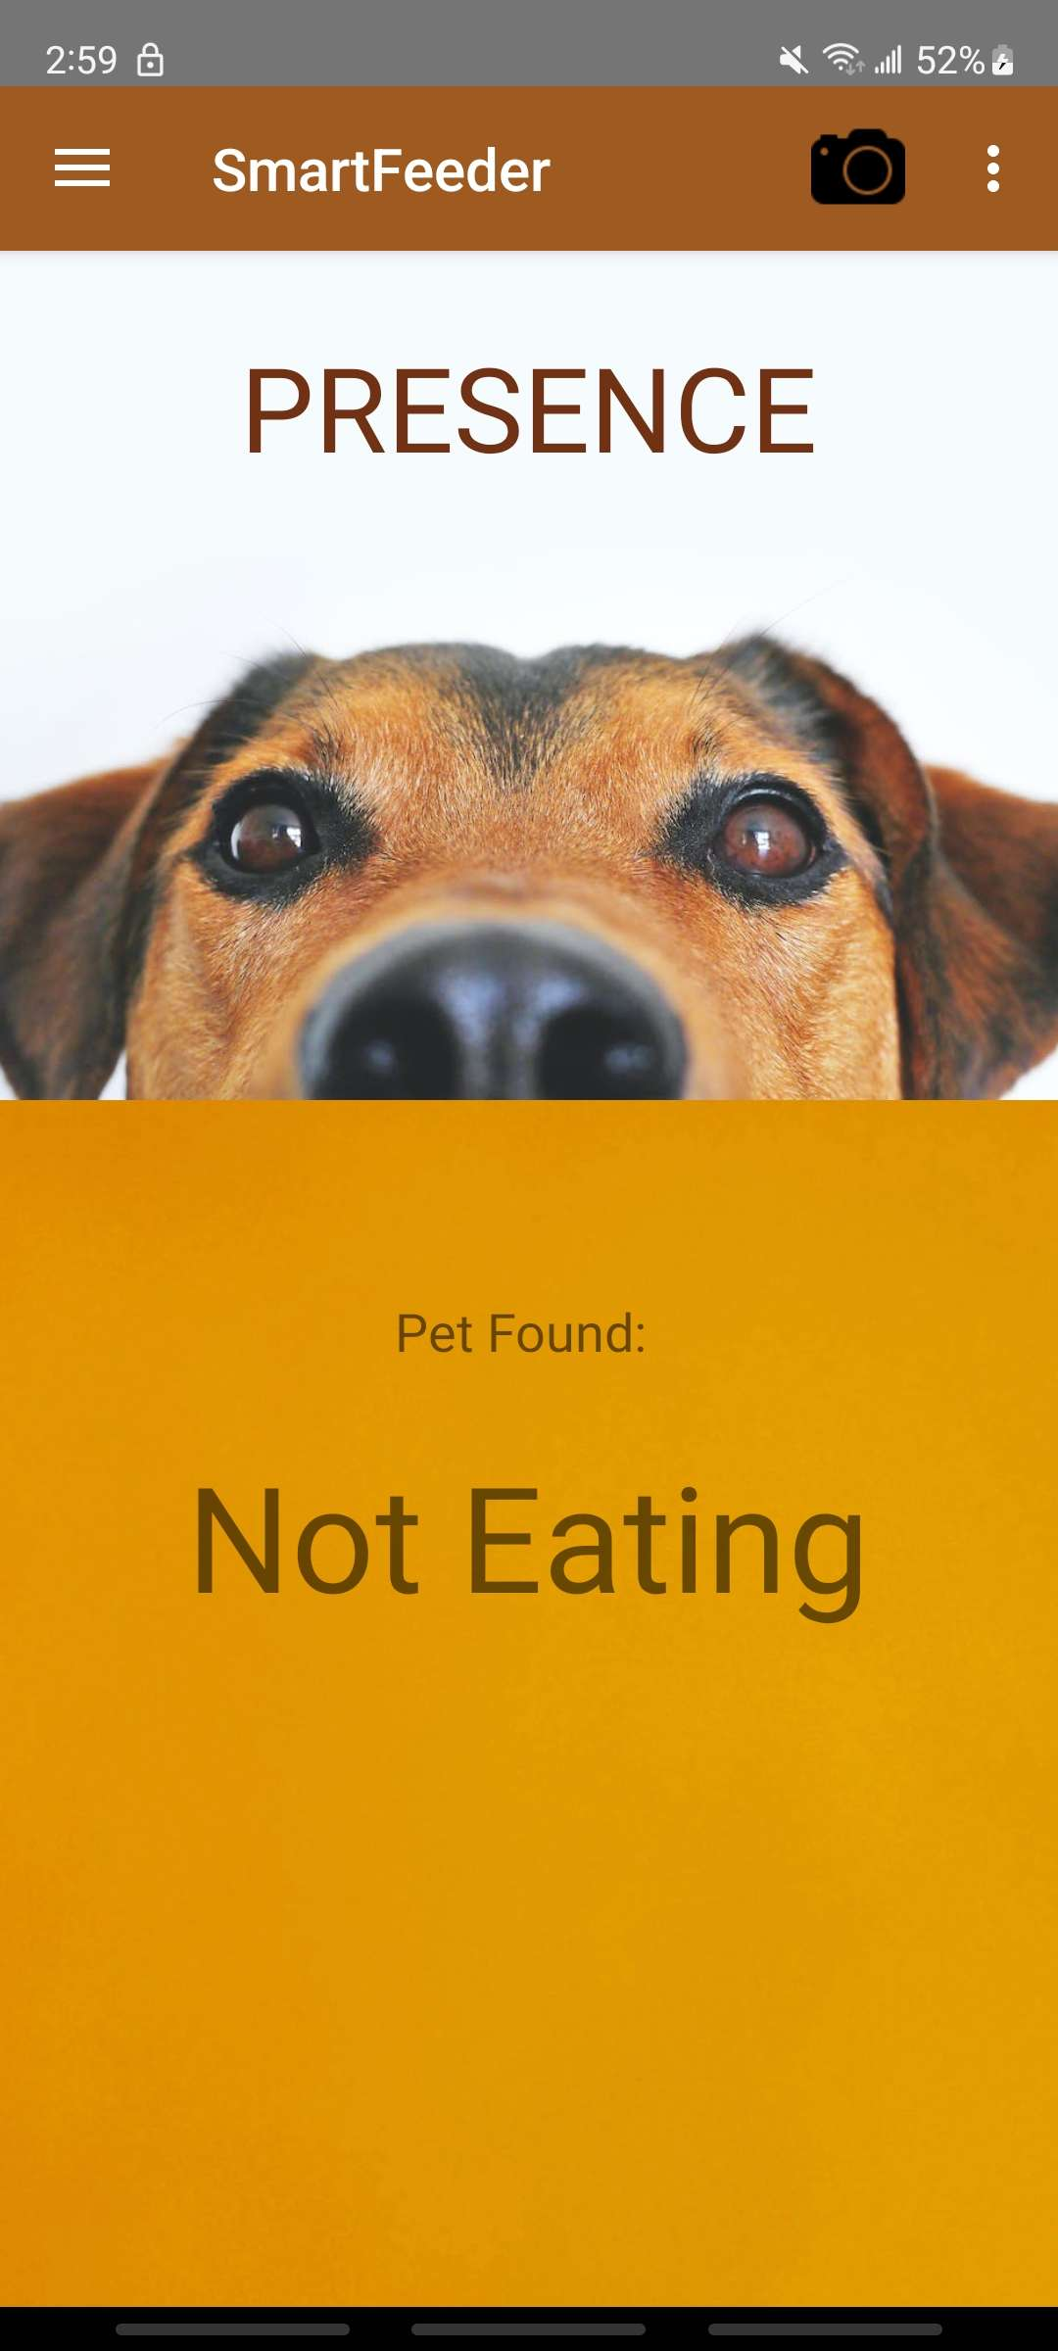
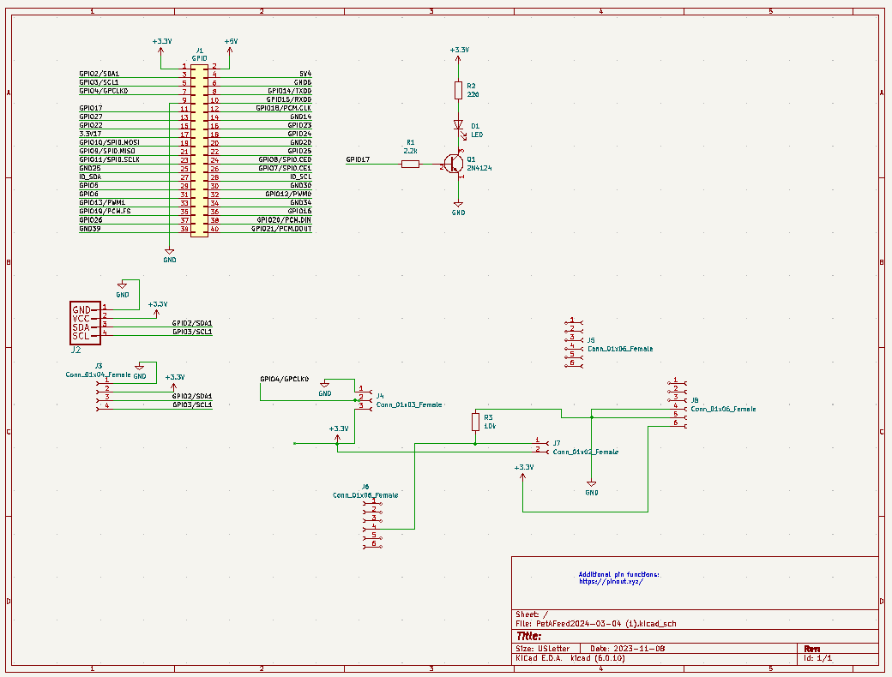
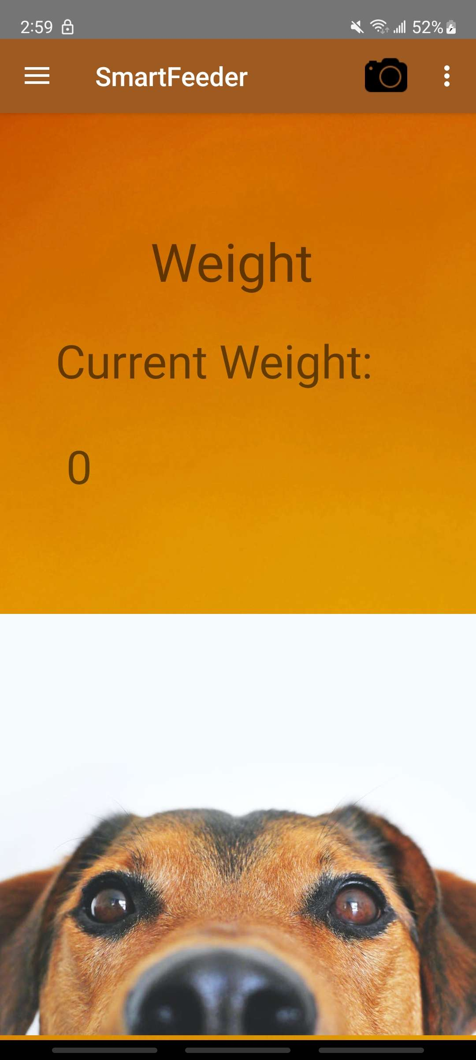
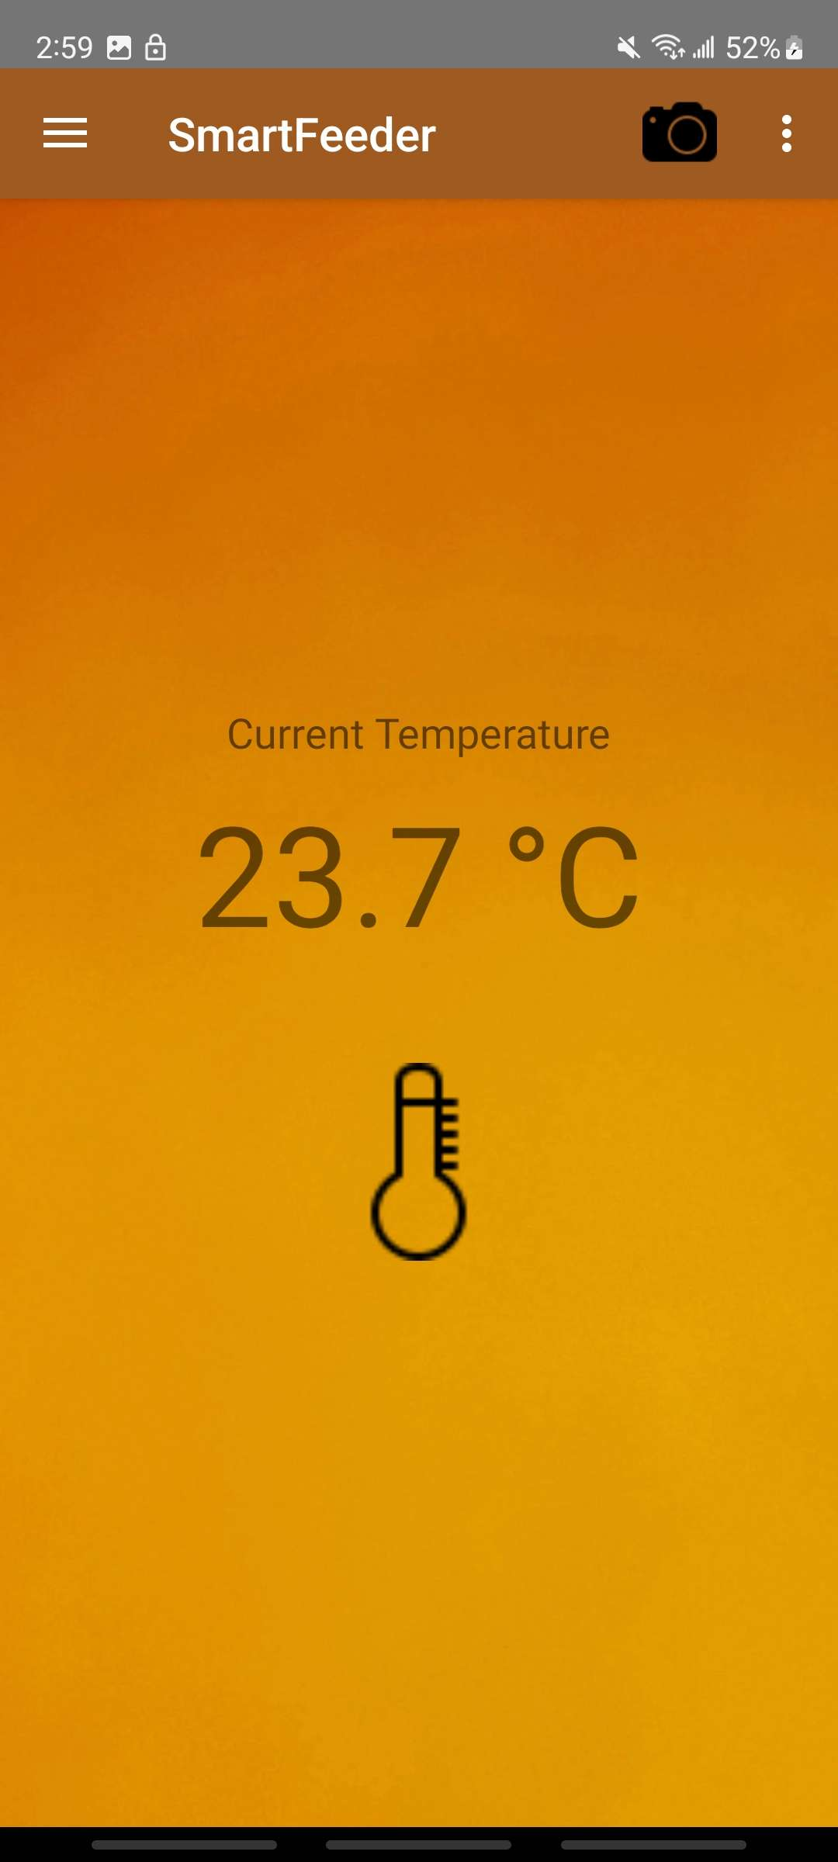
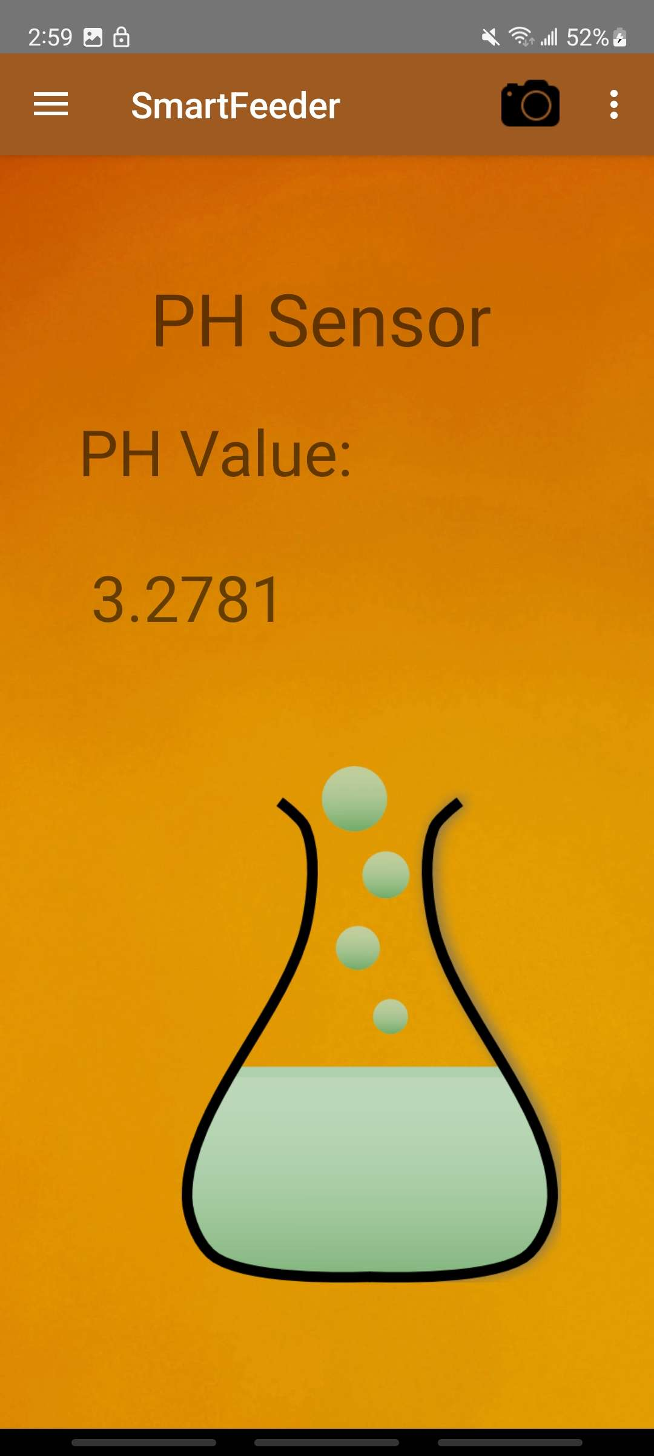
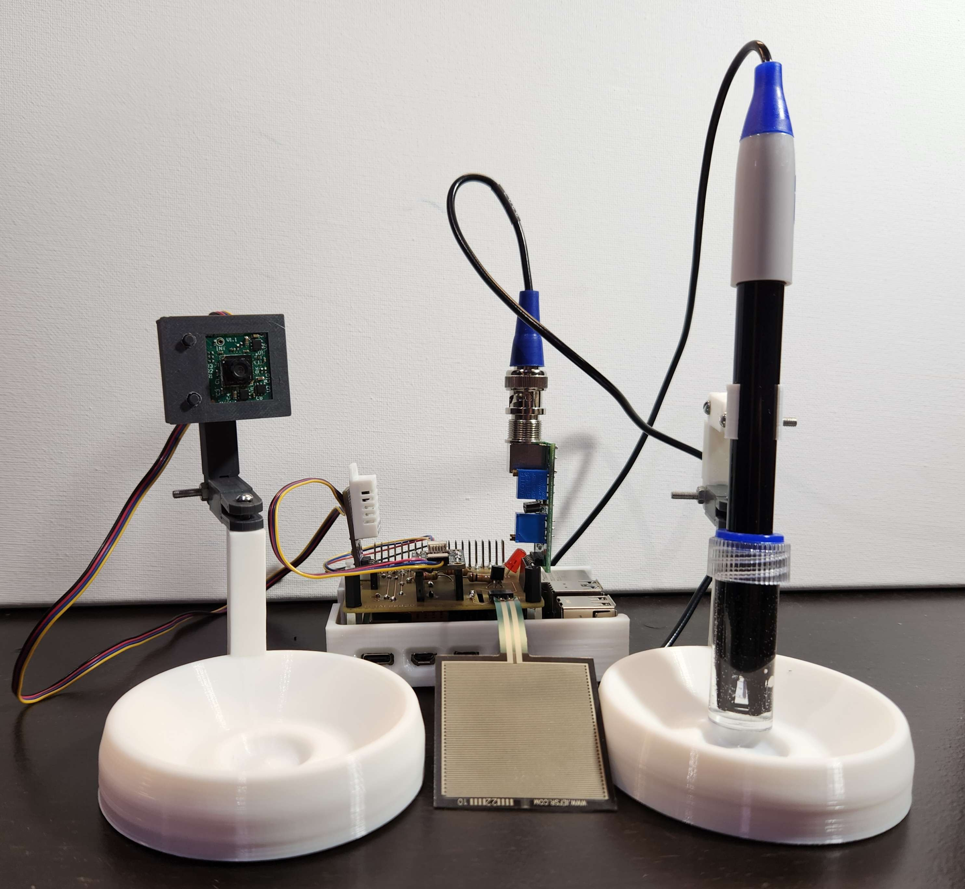
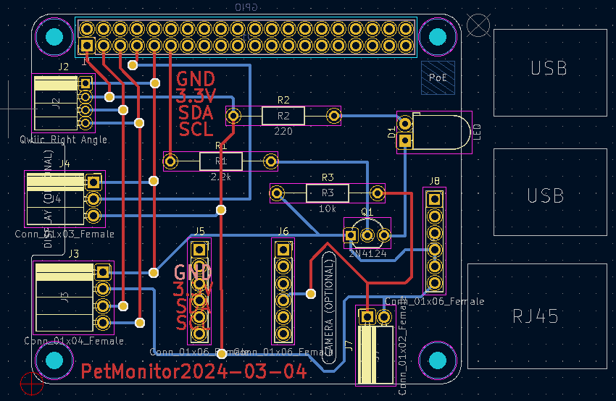
Smart Pet Monitor
Jasnam Gill, Aaron Jara, Robert Rowlison, Damanpreet Singh, Computer Engineering Technology
INTRODUCTION
This project presents a cutting-edge pet healthcare monitoring system designed to improve the welfare of pets. The system enables tracking of vital health metrics including changes in weight, PH levels in drinking water, and ambient room temperature. It also allows the user to monitor when the pet is eating or drinking. It caters to the increasing need for pet care solutions in household monitoring, providing a holistic approach to managing pet health.
CIRCUIT BOARD METHOD
Our PCB has all the sensors connected to one PCB board. The ADS1115 (analog to digital converter), AM2302 (temperature sensor), PH-4502C (PH sensor connector), and the Resistive 3us Analog sensor are all directly connected to the PCB along with a QWICC connector for the SEN-21231 (Presence Sensor). The Resistive 3us Analog sensor requires a 10k resistor which is also on the PCB. The Resistive 3us Analog sensor is connected on the bottom right using the J5 pin on the ADS1115 and the PH-4502C is connected on the right using the J6 pin on the ADS1115. The AM2302 is connected on the left connected to the pins on the pi. The SEN-21231 is connected using a QWICC connecter on the left of the PCB.
MOBILE APP RESULTS
Our app allows users to login and register using credentials that are stored in secure database on firebase. The app has four pages after the login/ registration pages they are the home, temperature, weight, presence, and PH pages each page allows the user to see the values given by sensors on the pi and pet bowls. The temperature page gives the temperature around the bowls. The weight page allows the user to see how much their pet weighs and the PH page allows the user to see the PH level of the water in bowl. The presence page shows if the pet is eating/drinking from the bowls.
DATABASE
The database is on firebase where we have a table for the users which saves users logins and passwords in a secure manner. We also have another table for the values from the sensors with the values from the sensors being sent to the pi then the pi sending the values to firebase using pyrebase. Then using the values the data in the app is updated to reflect the readings from the sensors.
TESTING
The testing done was having a pet be in front of the presence sensor and apply pressure to the weight sensor to see if the value changed in the app to make sure the app is connected to database and the pi can send data to the database. We also tested different liquids to see the ph values change and had the temperature sensor in different environments to see the changes.
ENCLOSURE DESIGN
Our enclosure has the pH sensor able to be moved away from the water bowl when the owner doesn’t want to measure the pH of the water. We also have a presence sensor between both bowls to track if the pet is drinking or eating. The temperature and weight sensor are both directly on the raspberry pi.
Login Page
Home Page
Presence Page
PCB Schematic
ACKNOWLEDGEMENTS
Professors, etc.
PCB Design
Weight Page
Temperature Page
PH Page
Notes:
Section Start Slide

